Slide 1


Market experts on
Global Menstrual Cups Market

Slide 2
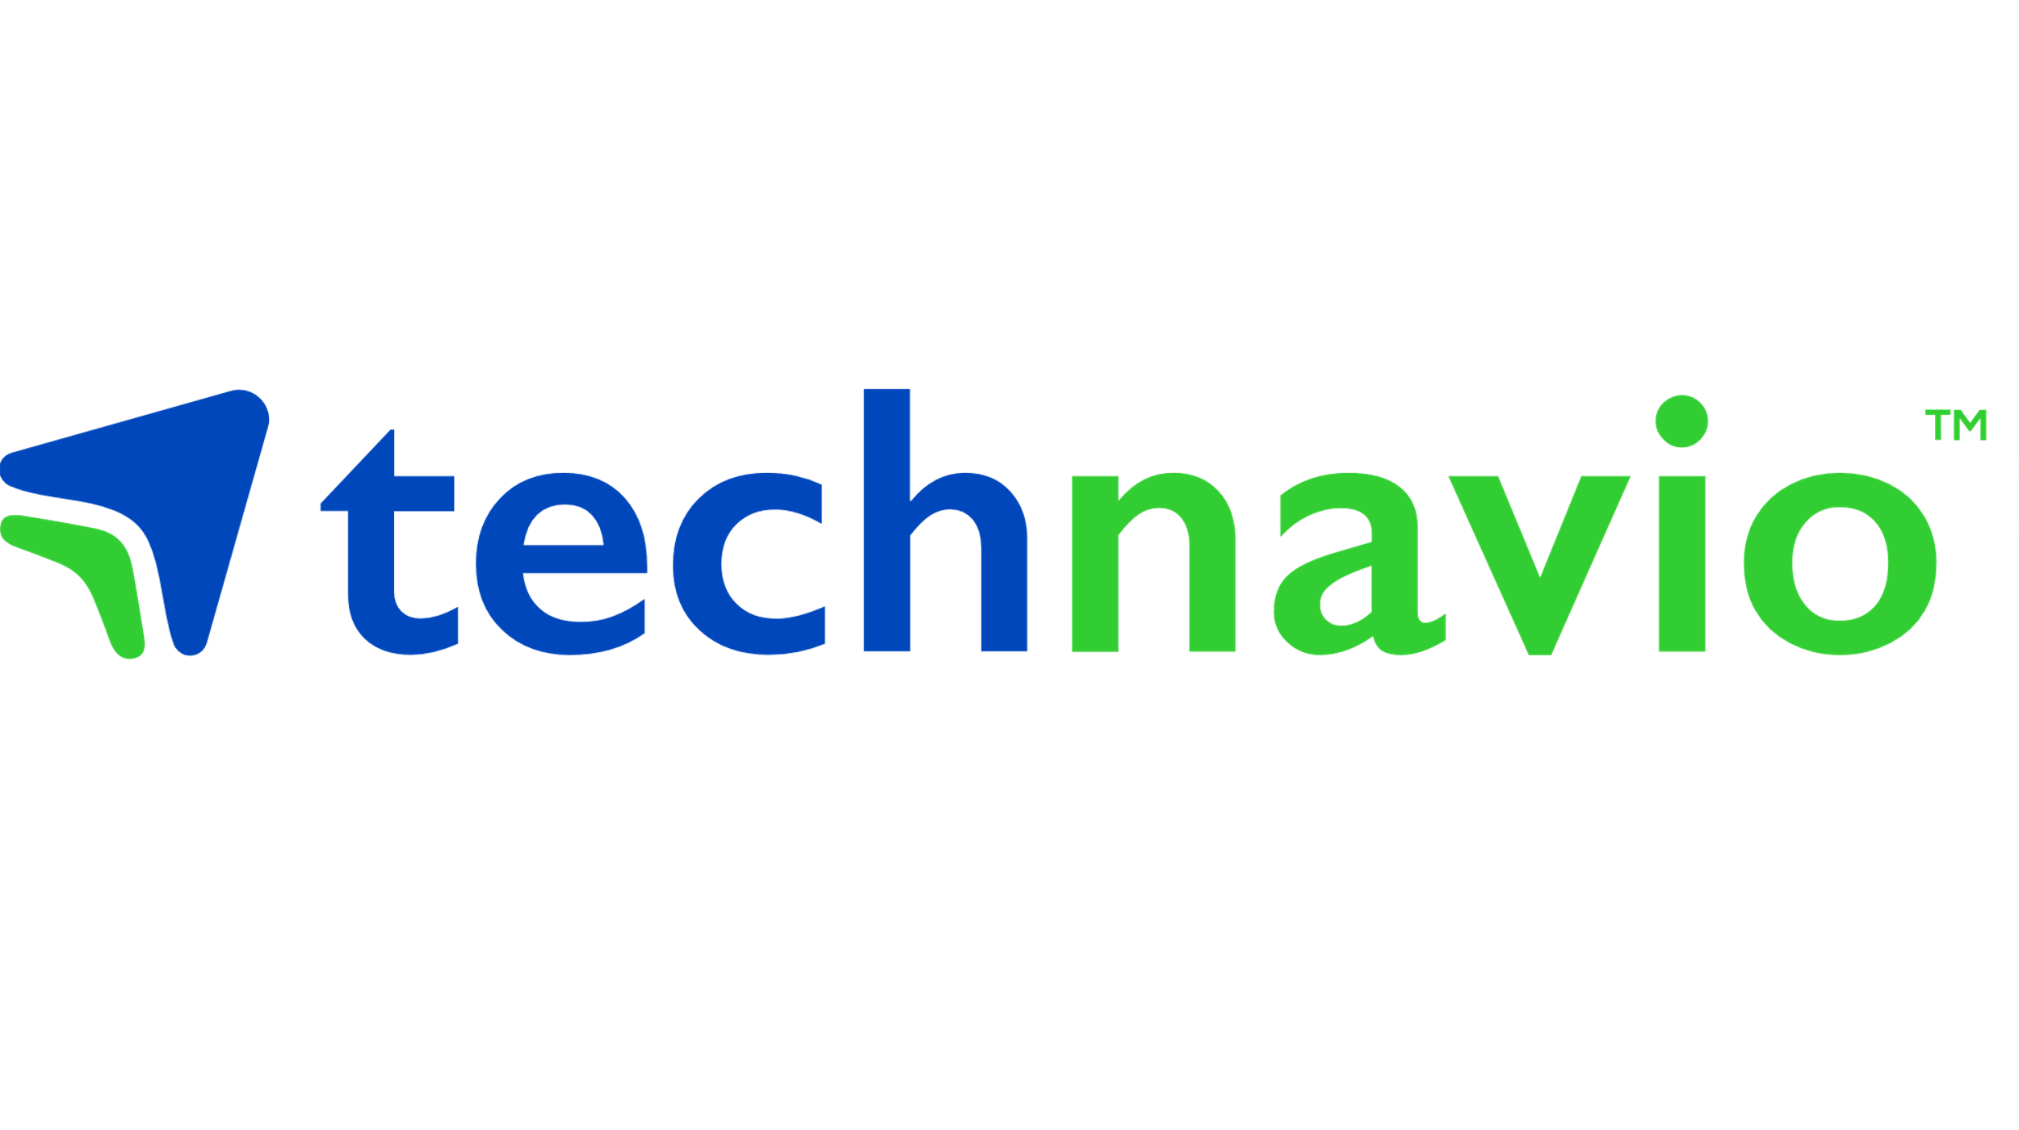
Demand States
The strong penetration of the internet and e-commerce websites are helping vendors to sell menstrual cups extensively

Slide 3

How does digital healthcare options enhance the menstrual health of women?

Slide 4


“The advent of smart reusable menstrual cups helps in maintaining vaginal pH balance and are artificial fragrance free.”
as per a senior research analyst at Technavio

Slide 5

The presence of multiple vendors operating through various distribution channels will augment market growth in North America
FREE SAMPLE REPORT
XX% of global incremental growth will come from North America

Slide 6
Other regions covered in our report

Slide 7

The purchase of menstrual cups is gaining traction in the market due to following reasons
They are cost-effective
Reusable in nature
Environment-friendly

Slide 8

Leading companies in the Menstrual Cups Market
Anigan Inc.
Diva International Inc.
Earth Care Solutions
Merula GmbH
Sckoon Inc.
LOON LAB INC.
Lune Group Oy Ltd.
Me Luna GmbH
Mooncup Ltd.
The Keeper Inc.

Slide 9





Some facts about Technavio
Reports Cover: Market Scenarios, Vendor landscape & Industry Road Maps. Option to customize report & access to analysts on every report purchase
10,000⁺
Reports published
8000⁺
Technology covered
Visit us here:
www.technavio.com
500⁺
Industry Reports
50⁺
Countries covered
North America
Europe
Asia
Chicago, USA
London, UK
Bangalore, India

